Slide 1
Taxonomic classification of ants (Formicidae) from images using deep learning
Marijn JA Boer
marijn.boer@naturalis.nl
February 6th, 2018
Supervisor: dr. Rutger Vos

Slide 2
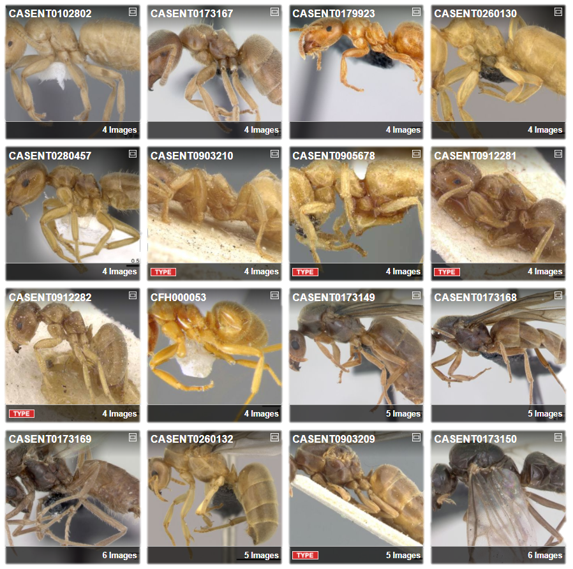
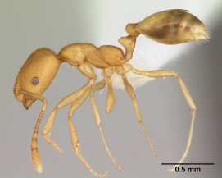
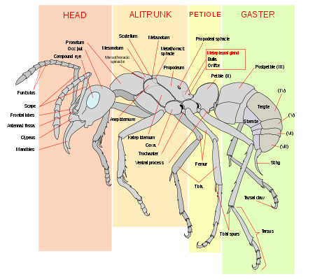
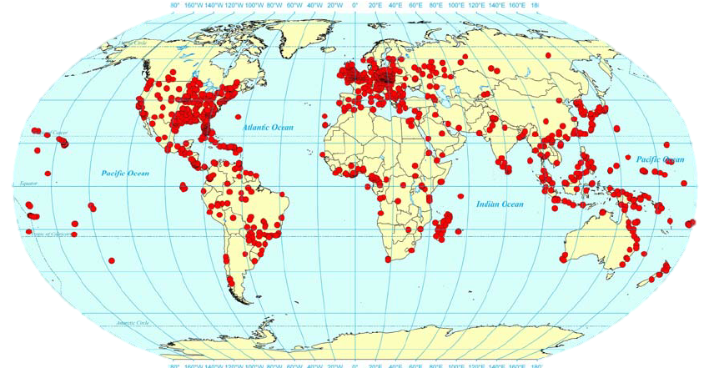
Ant Taxonomy
Global
Diverse
Identification
Monomorium pharaonis
Source: https://en.wikipedia.org/wiki/Ant
Wetterer JK. Worldwide spread of the pharaoh ant, Monomorium pharaonis (Hymenoptera: Formicidae). Myrmecological News. 2010;13: 115–129.
Photo by April Nobile / From www.antweb.org. Accessed 31 January 2018
AntWeb. Available from: https://www.antweb.org/images.do?rank=species&name=flavus&genus=lasius. Accessed 31 January 2018

Slide 3
Important to know the species
Need to know species because?
Important to ecosystems
Bioindicator
Richness surrogate?

Slide 4
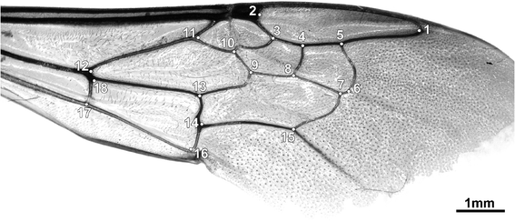
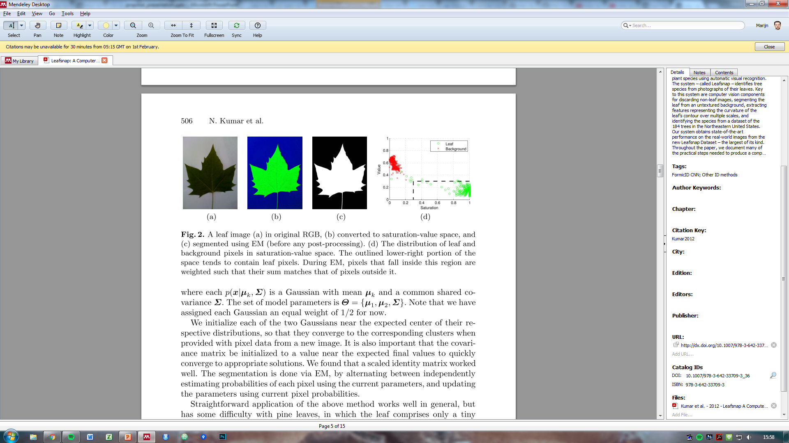
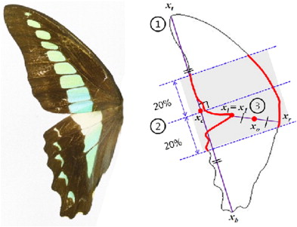
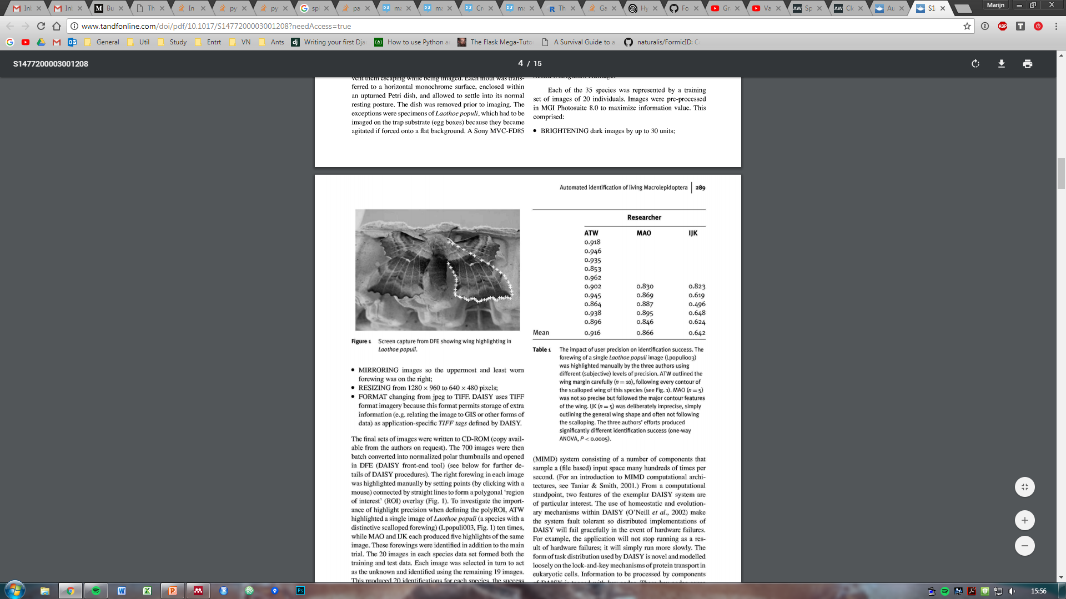
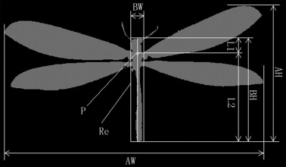
Computer vision
Machine learning
Learns on introduced features
Gerard, M. et al. Apidologie 46, 644–653 (2015)
Watson, A. T. et al. Syst. Biodivers. 1, 287–300 (2004)
Kumar, N. et al. in Computer Vision – ECCV 2012 502–516 (2012)
Kang, S.-H. et al. J. Asia. Pac. Entomol. 15, 431–435 (2012)
Wang, J. et al. Knowledge-Based Syst. 33, 102–110 (2012)

Slide 5
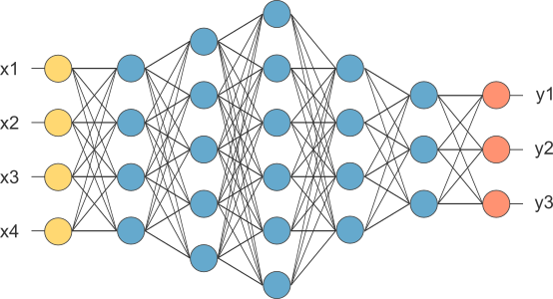
Deep learning
More promising
Higher accuracy
Feature learning
http://www.opennn.net/images/dep_neural_network.png

Slide 6
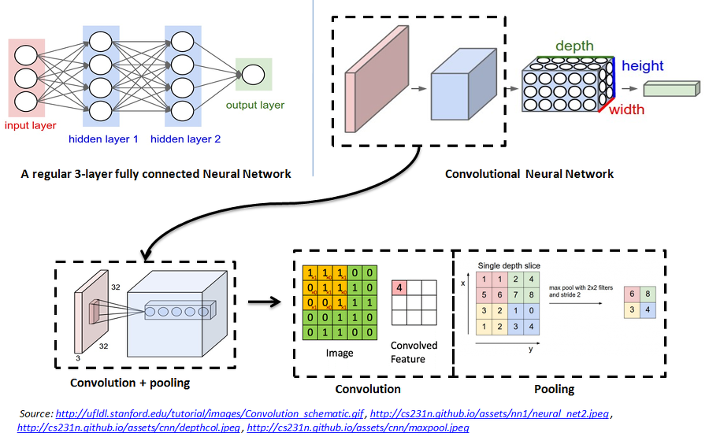
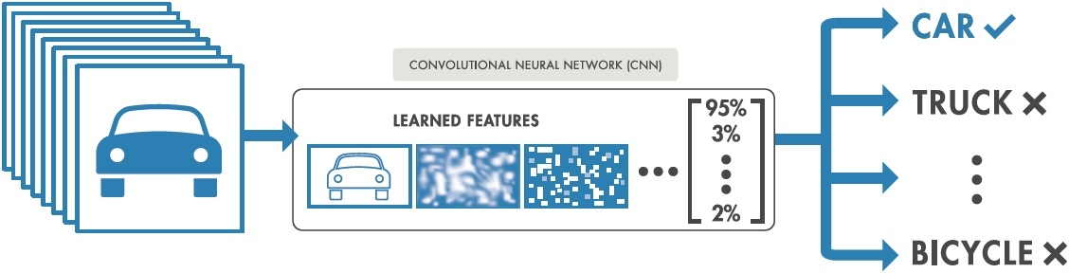
Convolutional neural network
1 | 0 | 1
0 | 1 | 0
1 | 0 | 1
https://nl.mathworks.com/content/mathworks/nl/en/discovery/convolutional-neural-network/_jcr_content/mainParsys/image.adapt.full.high.jpg/1508999492829.jpg

Slide 7
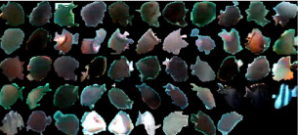
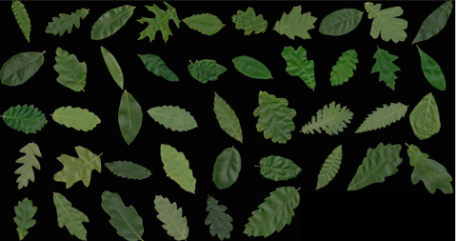
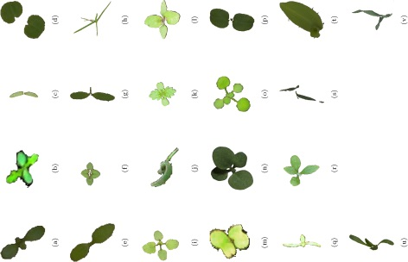
DL examples
Deep-Fish: 98.64%
Deepplant: 99.5%
Weed/crops: 86.2%

Slide 8
FormicID Project
What is the aim of this project?
Naturalis aim
CNN multi-view

Slide 9
Questions

Slide 10
Problems

Slide 11
Approach
Creating a dataset
Neural Network training
Neural network testing

Slide 12
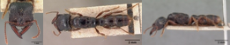
AntWeb

Slide 13
FormicID-97
97 species
Minimum of 68 images
10,204 images

Slide 14
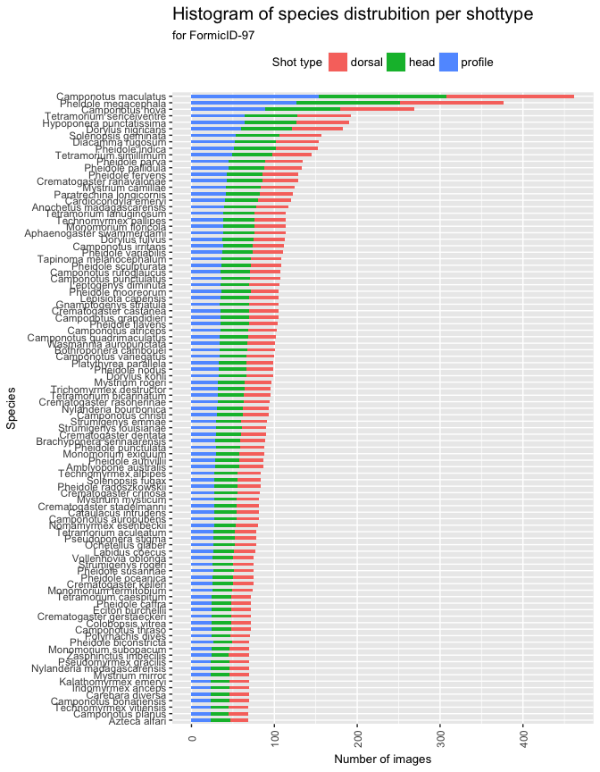
Species distribution
Switch axis!

Slide 15
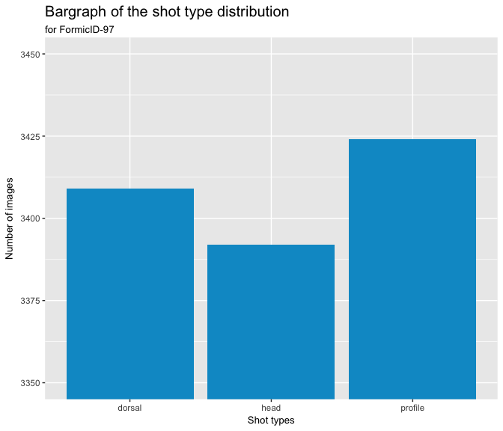
Shot type distribution

Slide 16
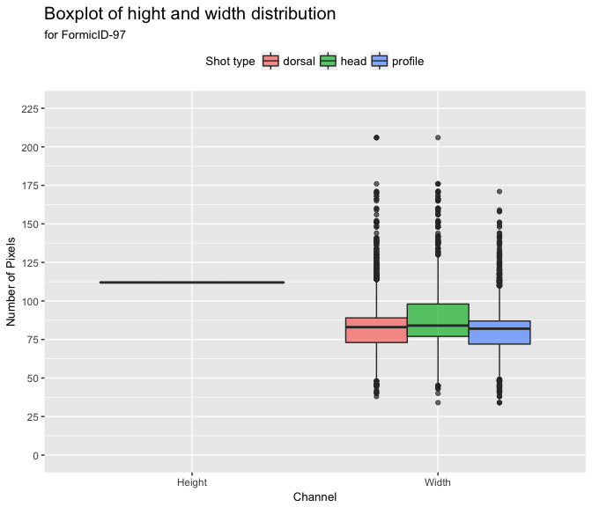
Image dimensions

Slide 17
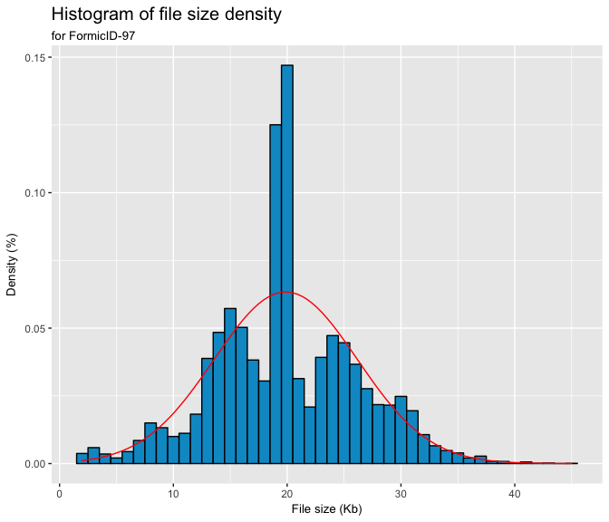
File size

Slide 18
Network architecture
Existing one
Examples…
…
New one
With these options:
…
…

Slide 19
Testing
First training
Validation
Then training
Top-1
Top-5

Slide 20
Timeline

Slide 21
Timeline

Slide 22

Thank you for your attention!
marijn.boer@naturalis.nl
https://cdn.pixabay.com/photo/2015/10/25/18/57/thumbs-up-1006172_960_720.png

